Slide 1
IT Project Bank Account Management System
By: Mohamed Aden Ighe
Ref No.: BSD123AY943
Supervisor: Dr. SHADI HILLES.
For Semi-final (October/November 2015)

Slide 2
Introduction
The Bank Account Management System (BAMS), is an application for maintaining a person's account in a bank, which is responsible for the daily transactions.
A local bank, BICM Bank is responsible for managing the system 24/7.
It retains the information of a persons account, withdrawals, deposits and viewing account details.
There a 2 types of A/C types which include Personal and Savings. It can’t be changed once the account is created. Instead, the client can open another account with another A/C type.

Slide 3
Introduction
A client opens accounts at a branch. Each account is uniquely identified by an account number starting with 10 to 999.
It has an exact balance and a withdrawal, transfer or deposit limit.
When a person does a transaction such as deposit or withdrawal, it is required for the user to login for authentication before proceeding with the action. Otherwise, the transaction will be rejected.
This applies when a user requests his/her account to be terminated.

Slide 4
Stages of the Project (Main Menu)
1) Create New Account (to create new account)
Enter Account No.
Account Type (Current/Savings)
2) Cash Deposit (to deposit money from your A/C)
3) Cash Withdrawal (to withdraw money from your A/C)
4) Balance Enquiry (to view your balance details)
5) Account Details (to view your A/C details)
6) [Request for] Account Termination (to request for A/C to be closed)
7) Exit the program (to leave to program for good)

Slide 5
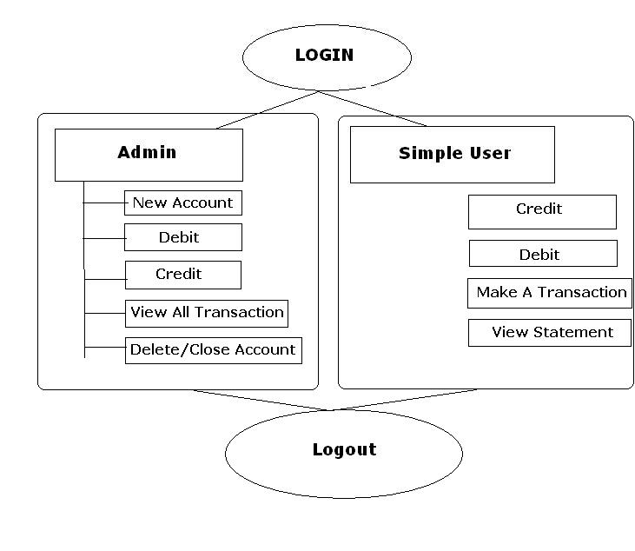
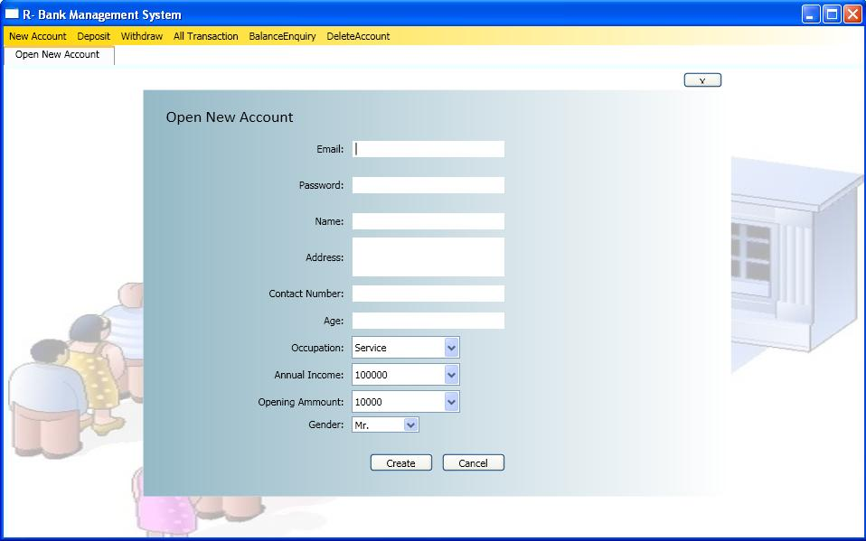
Related work (#1)
Title: R-Bank Management System (Open Source)
Author: Rahul Saxena
Site: C# Corner
Date created: 2 April 2010
Created using: Visual Basic and C# with SQL used as database.

Slide 6
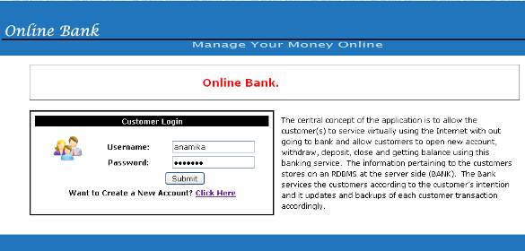
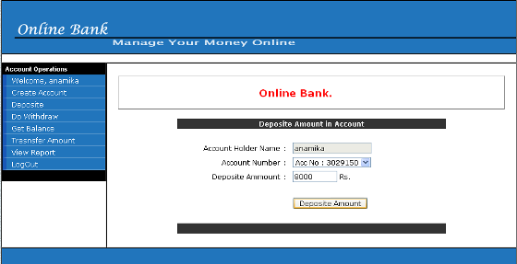
Related work (#2)
Title: Bank Management System
Author: TechZoo
Site: TechZoo
Date created: 15 October 2012
Created using: Java with Microsoft Access used as database tool.

Slide 7
System Analysis (Diagrams)

Slide 8
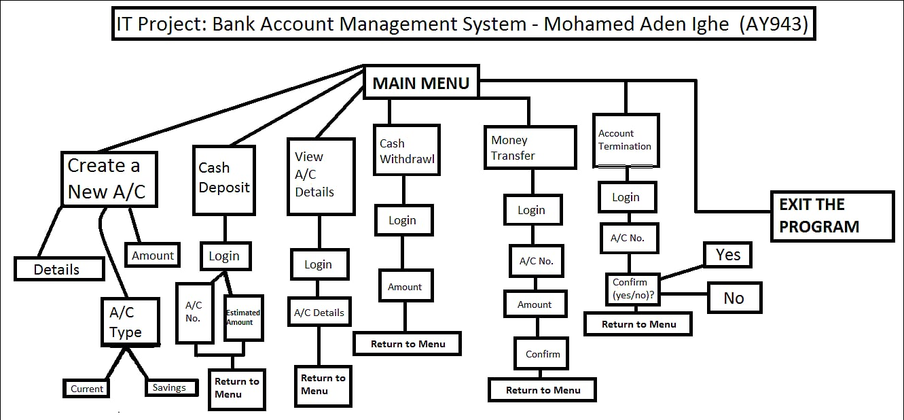
Diagram #1 (Flowchart diagram)

Slide 9
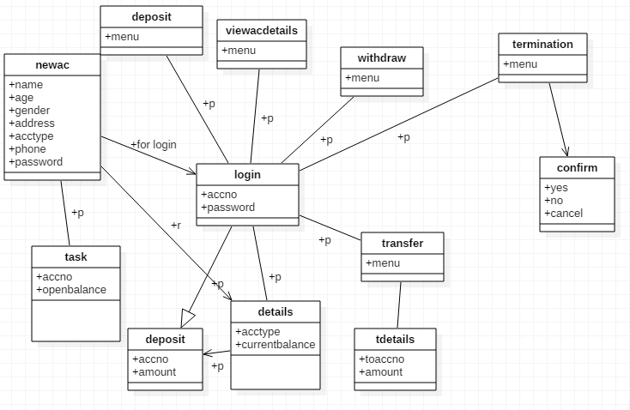
Diagram #2 (Class Diagram)

Slide 10
THE END By: Mohamed Aden Ighe

